Slide 1
Object Detection in an Urban Environment
Andres Murube Lindahl
2022/02/05

Slide 2
Index
Project overview
This section should contain a brief description of the project and what we are trying to achieve. Why is object detection such an important component of self driving car systems?
Dataset
Dataset analysis
This section should contain a quantitative and qualitative description of the dataset. It should include images, charts and other visualizations.
Cross validation
This section should detail the cross validation strategy and justify your approach.
Training
Reference experiment
This section should detail the results of the reference experiment. It should includes training metrics and a detailed explanation of the algorithm's performances.
Improve on the reference
This section should highlight the different strategies you adopted to improve your model. It should contain relevant figures and details of your findings.

Slide 3
Project Overview
The project goal is to use transfer learning techniques to accurately predict
vehicles, pedestrians and cyclists and
their position in the image
in video scenes that have been recorded.
This task is crucial in self-driving vehicles to ensure the correct and safe trajectory planning of the ego vehicle

Slide 4
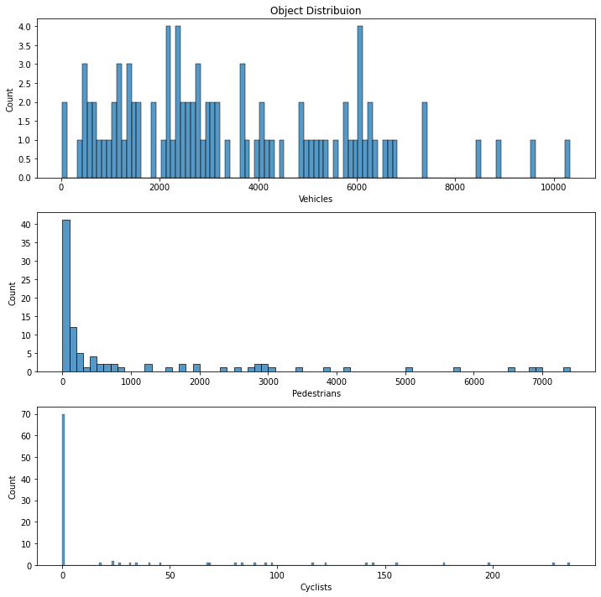
Exploratory Data Analysis Object distribution over the TFRecords
The figure shows the distribution of the objects that can be detected for all TFRecords available
It can clearly be observed that the #vehicles is widely distributed, whereas many frames do not have any cyclists or pedestrians
The resulting split should try to cover these distributions as well
Cars are well represented in the dataset. Cyclists and Pedestrians are less present

Slide 5
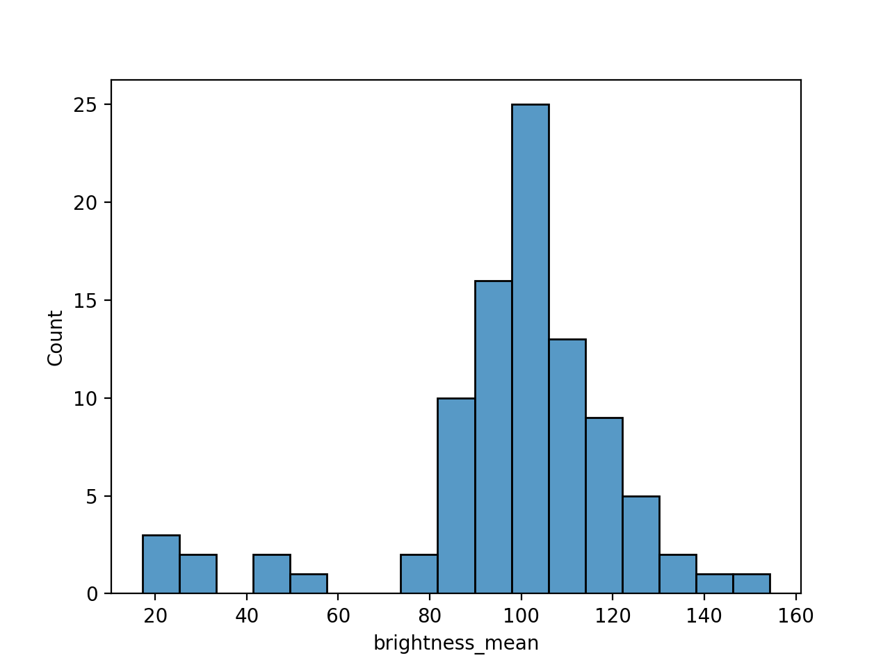
Exploratory Data Analysis Image Brightness (Day/Night scenes)
From the calculated perceived brightness, we can clearly identify what images have been taken during the day or night.
We want to take this into consideration when training the model. Otherwise, there is the risk of underperforming in night scenarios
The great majority of the sequences are taken during the day. Only 9 out 100 were during the night

Slide 6
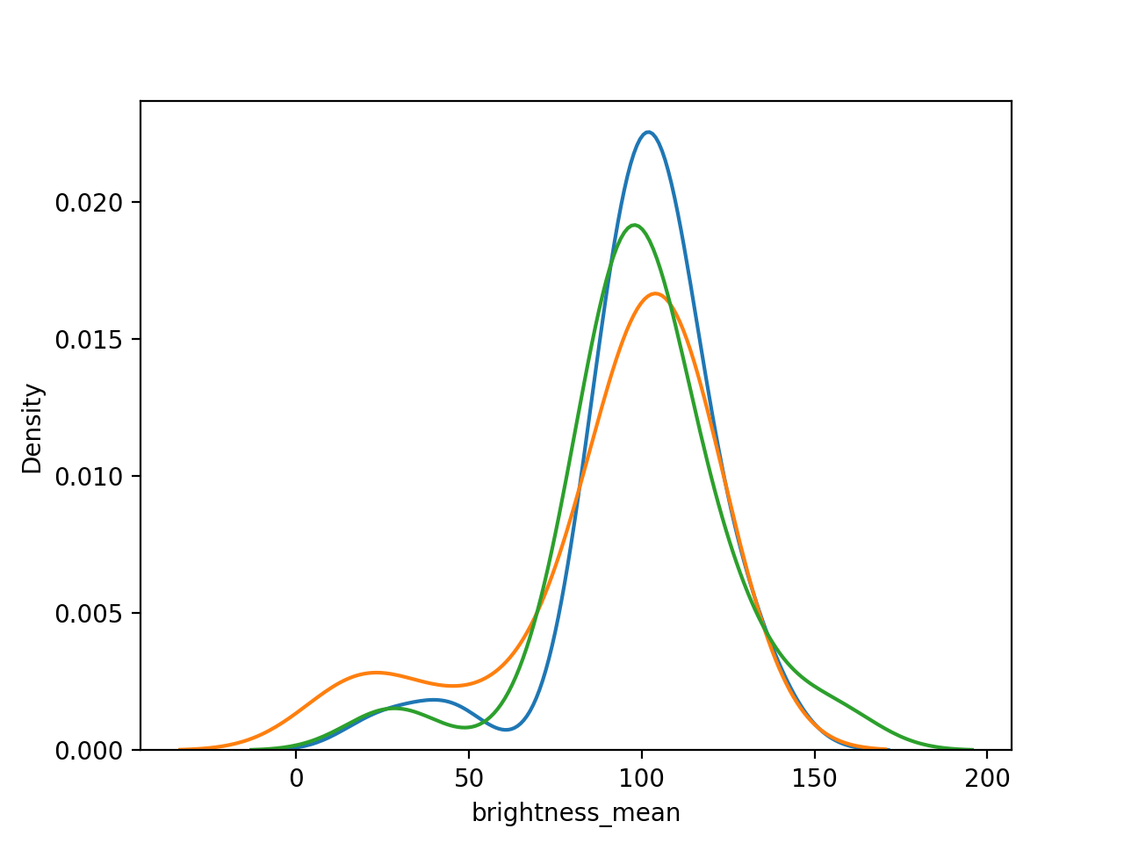
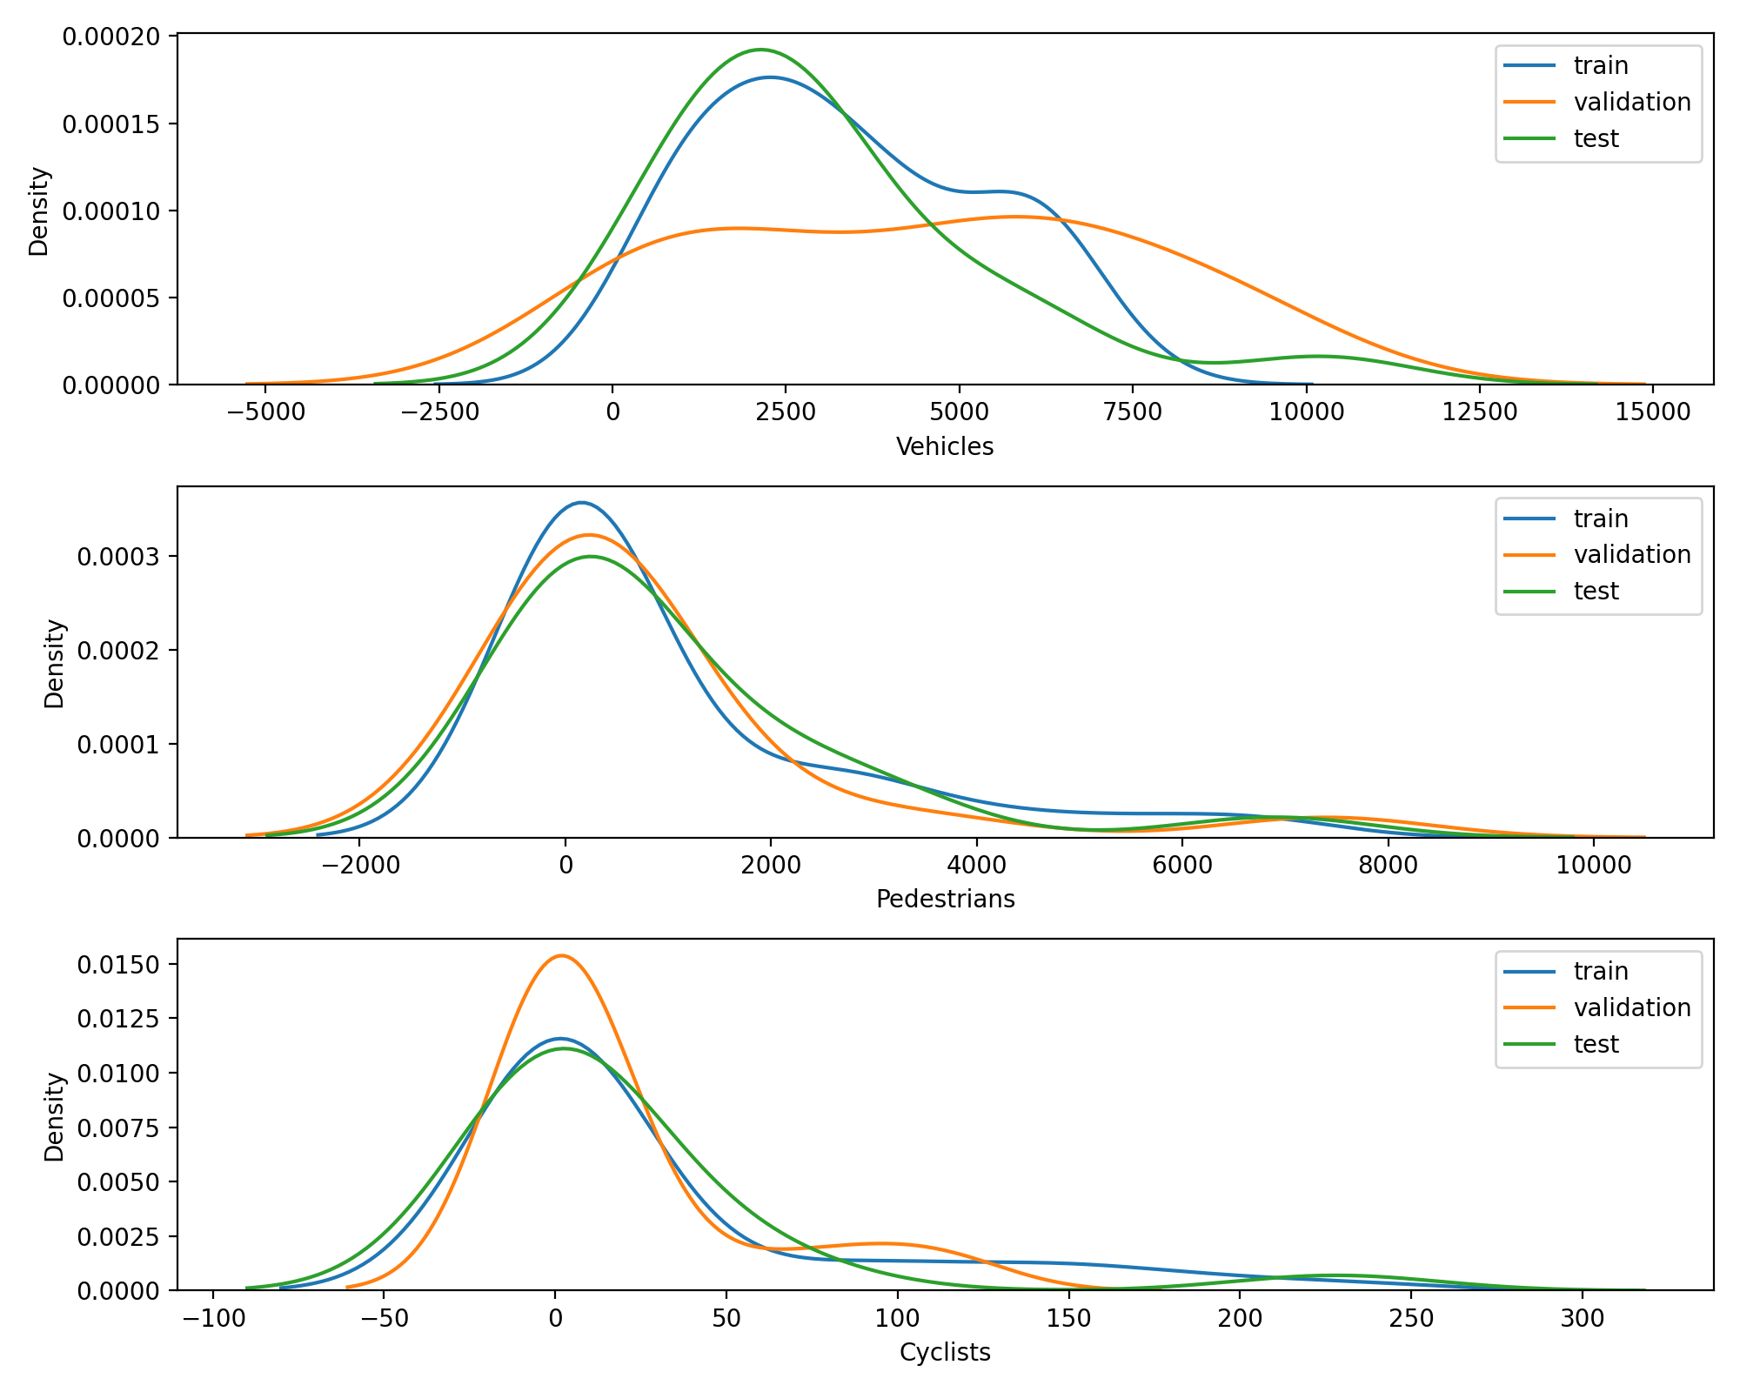
Split Creation
For the creation of the different splits, we will take the classical splitting approach of 60/20/20 and evaluate whether we get similar probability densities for the classes that we evaluated before. This split can be chosen as we have a fairly large number of measurements
From the probability distributions it can be observed that the shuffle procedure create similar datasets for training, validation and test. It will be necessary to evaluate later, whether it is sufficient or if we must make use of data augmentation to increase the features that are currently under-represented

Slide 7
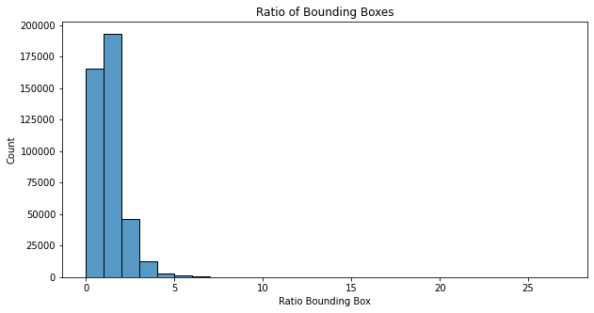
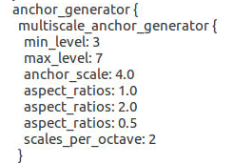
Bounding Boxes Ratio
The pre-defined aspect ratios are a good starting point and don’t seem to require tweaking

Slide 8
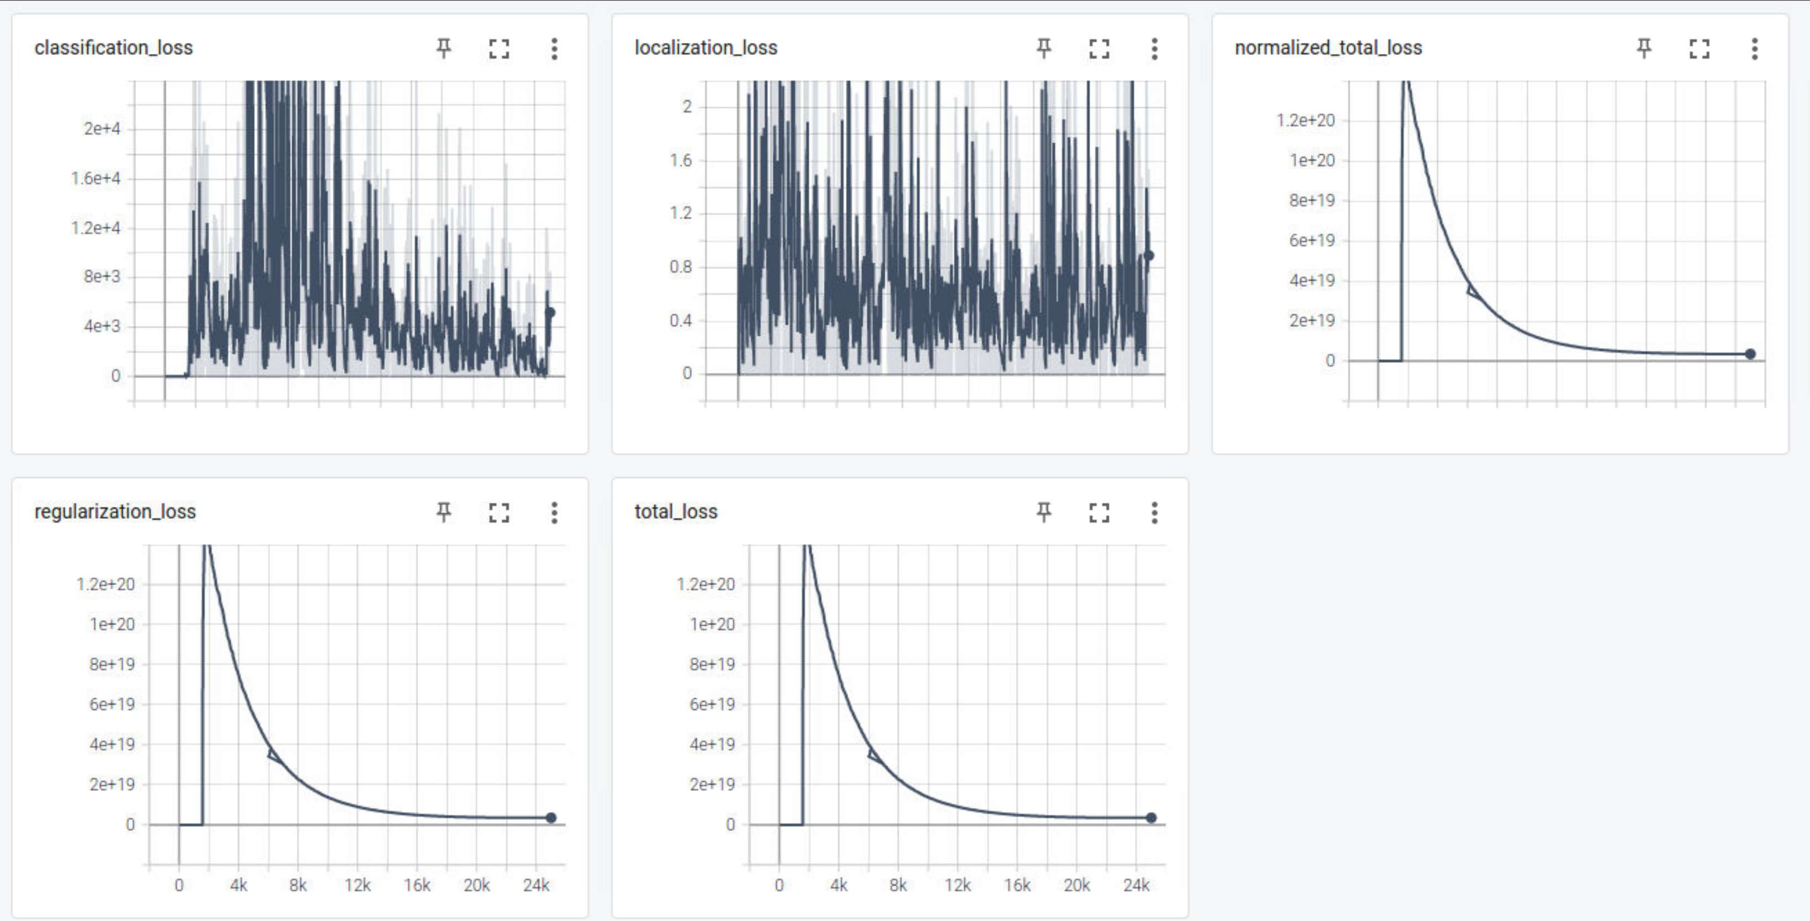
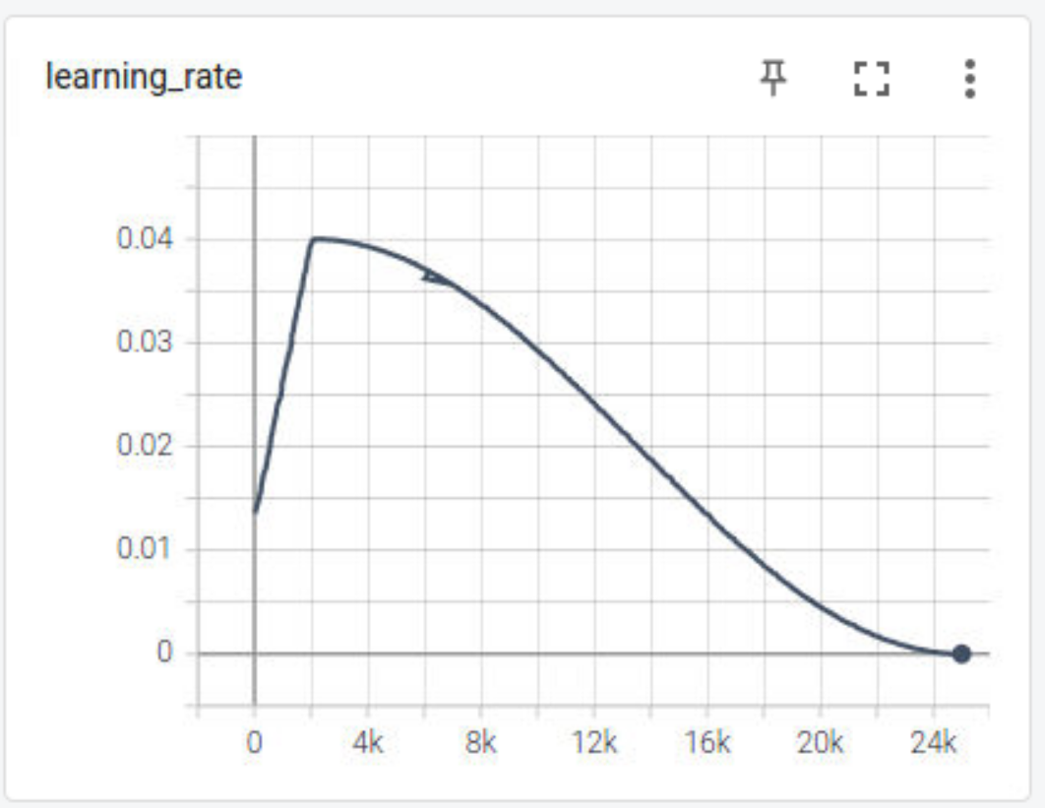
Training of Reference Model: Evolution of Loss
The huge losses are an indication that the learning value is too high!

Slide 9
Training of Optimized Model: Changes to the configuration
The following changes were done to improve the performance of the model:
Reduced the learning rate to avoid wrong learning of the model → large losses
Change of the optimization algorithm to ADAM
Include augmentations
random_rgb_to_gray
random_adjust_brightness
random_adjust_contrast
random_adjust_saturation

Slide 10
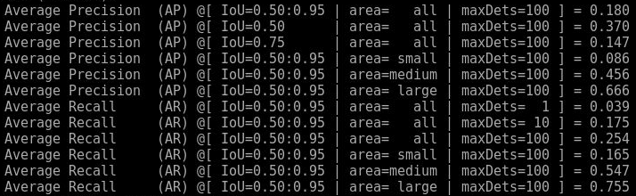
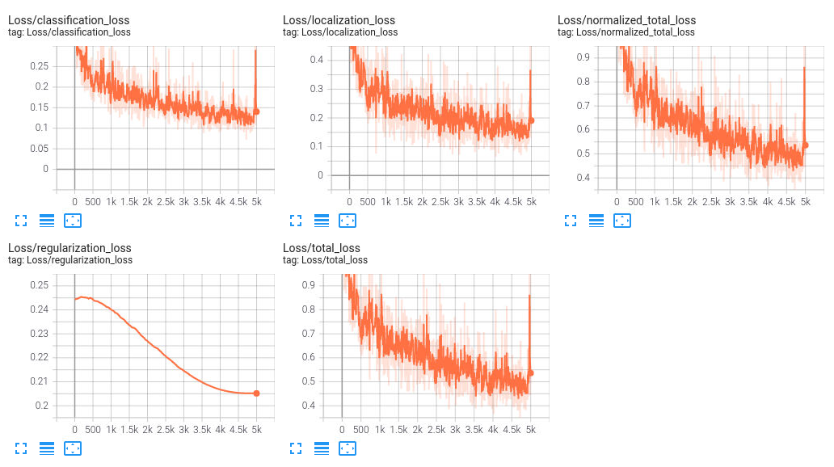
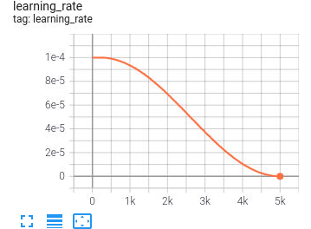
Training of Optimized Model: Evolution of Loss
The model training convergence has significantly improved

Slide 11
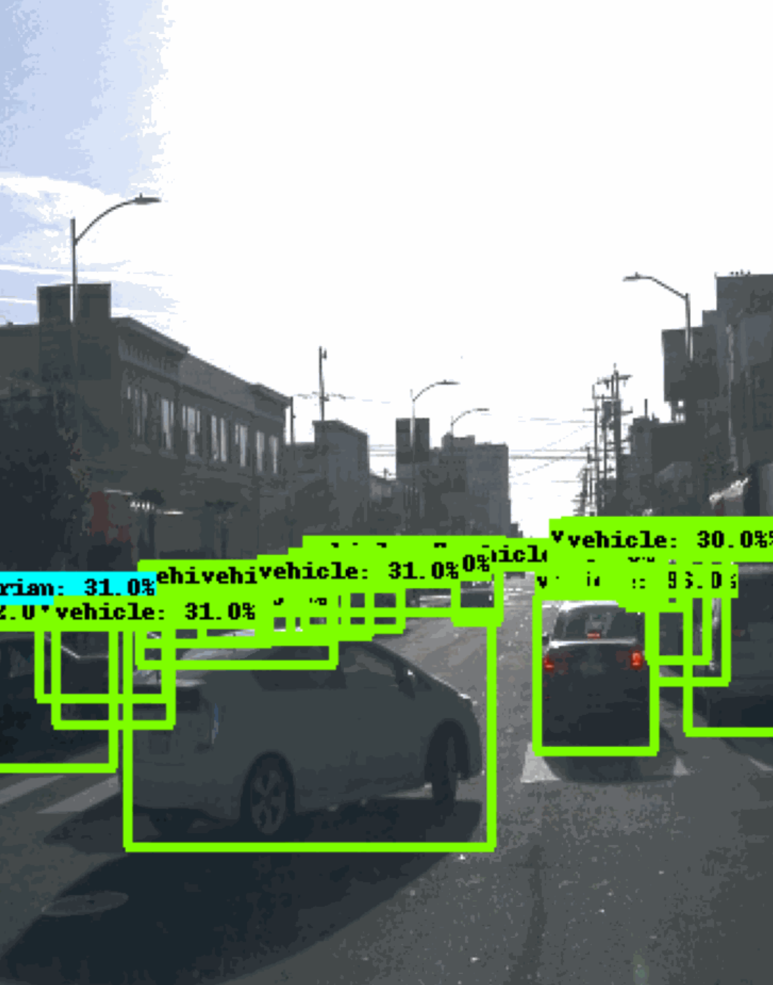
Further Possible Improvements
Due to GPU time restrictions I could not perform the training for more than 5k epochs. Increase the values as originally configured would improve the performance of the model
In the generated animations, it can be observed that the non-max suppression value was set too low (1e-8). Increasing this value to ~0.2 would reduce the number of windows significantly

Slide 12

Backup

Slide 13
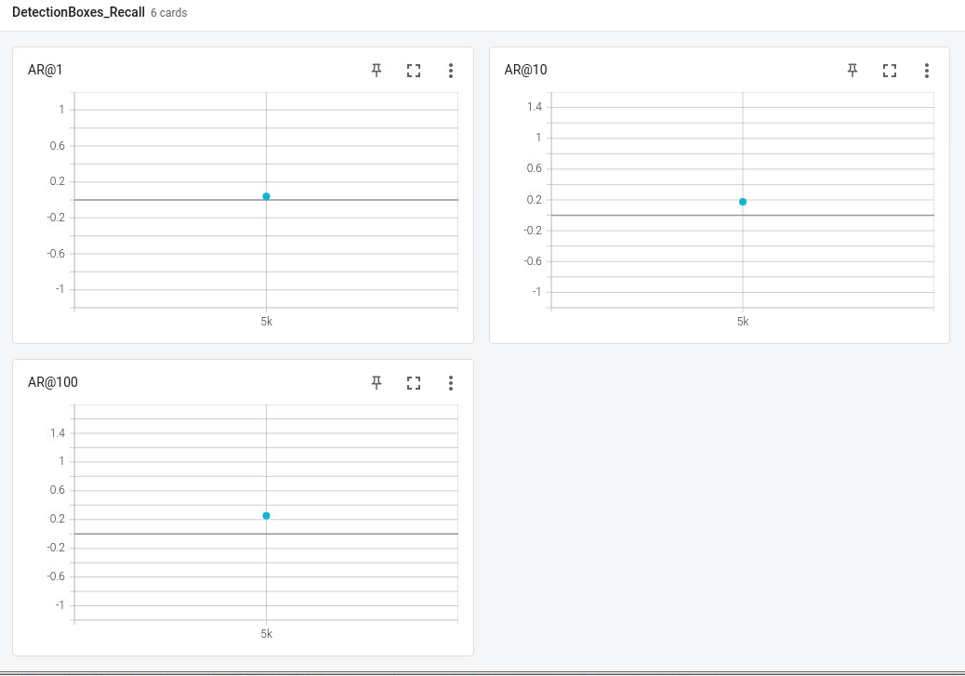
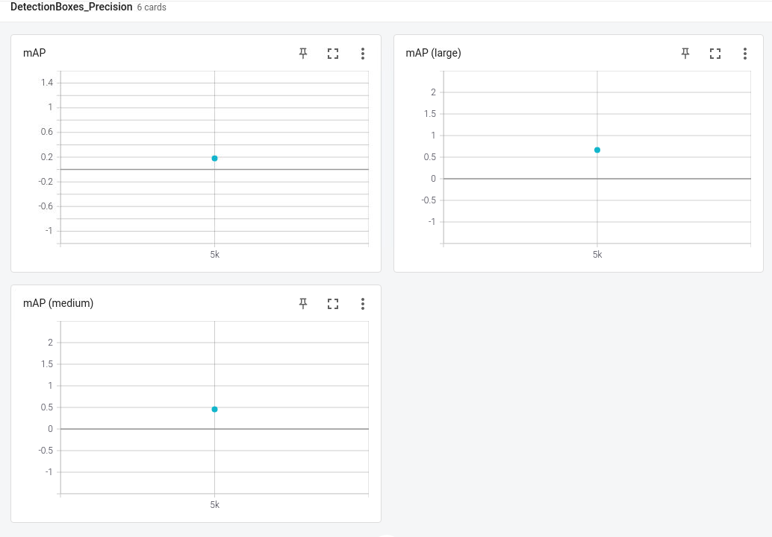
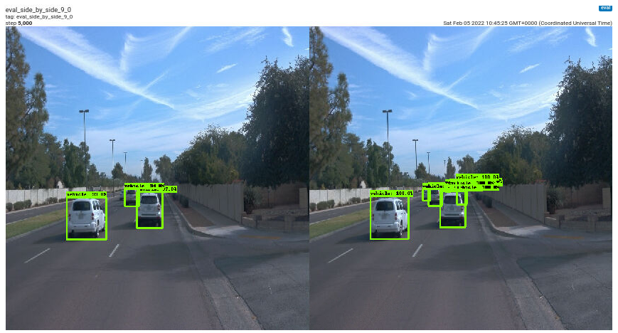
Optimized Model Evaluation - Tensorboard
Evaluation was only possible at the end of the training as there were memory issues with the udacity workspace

